Slide 1




Slide 2
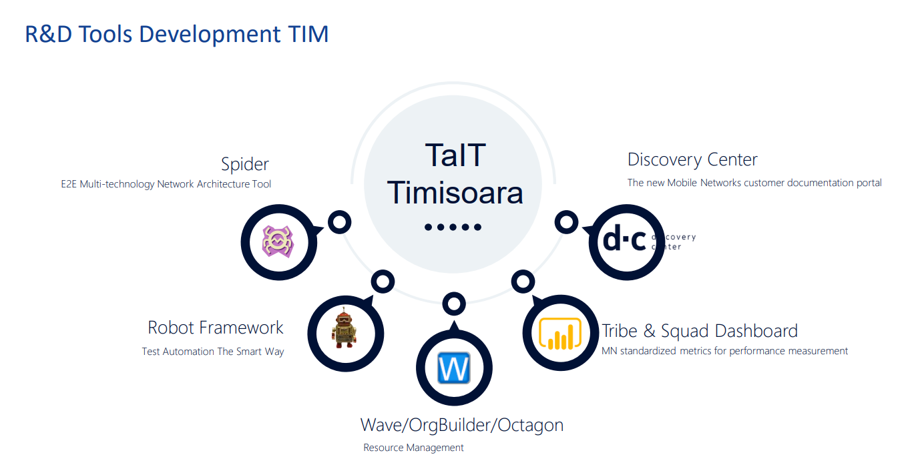

Slide 3
Tribe & Squad Dashboard - Development Squad​ -
@Andreea KOVACS – Scrum Master
@Loredana PAVEN
@Bogdan PONTA
@Raluca TOMA
@Răzvan SĂVULESCU
@Anca ȚOFEI
@Adelina ANCĂU
@Andrei SOLOMON
@Teodora BROTEA
Involving development teams in 5 sites: Hangzhou, Timisoara, Manilla, Wroclaw, Bangalore.​
Timisoara team joined the project in December 2017.​

Slide 4
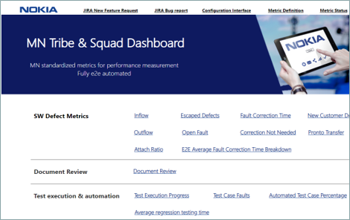
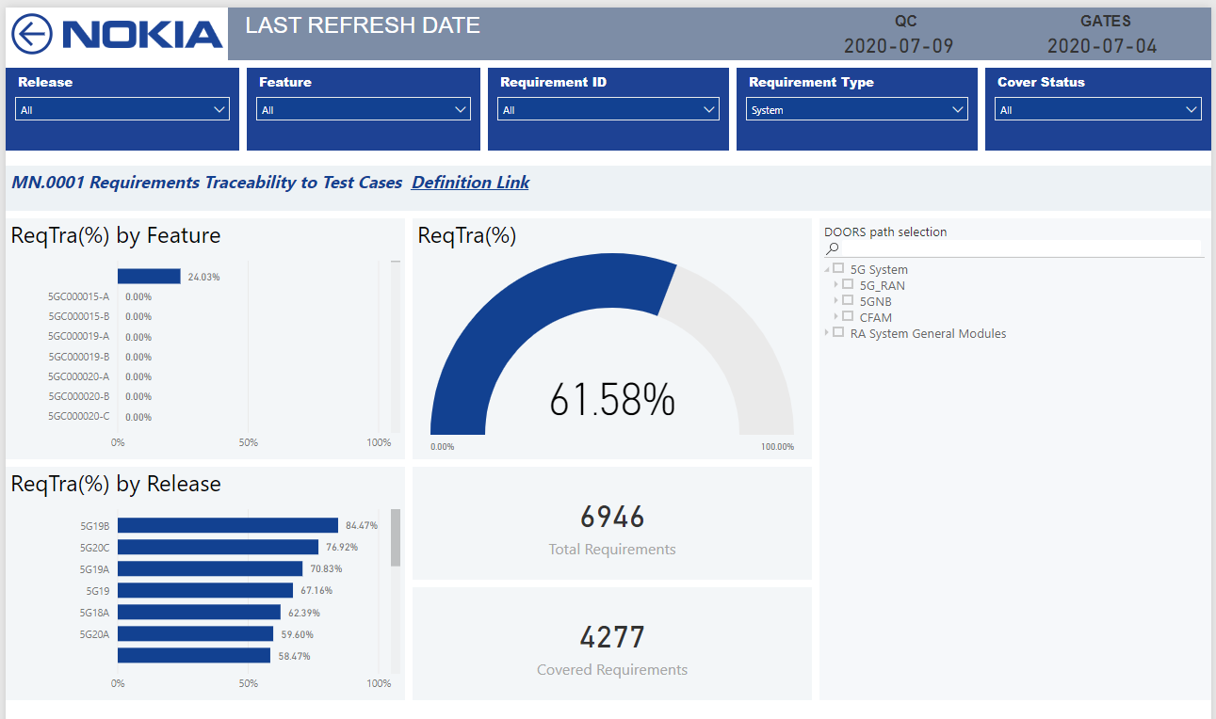
Tribe & Squad Dashboard – MN standardized metrics for performance measurement
About the project:
Aims to provide the following to the tribes and squads across MN:
• standardized metrics for performance measurement and analysis.
• automate the data collection and presentation so that no manual reporting or data collection is needed.

Slide 5
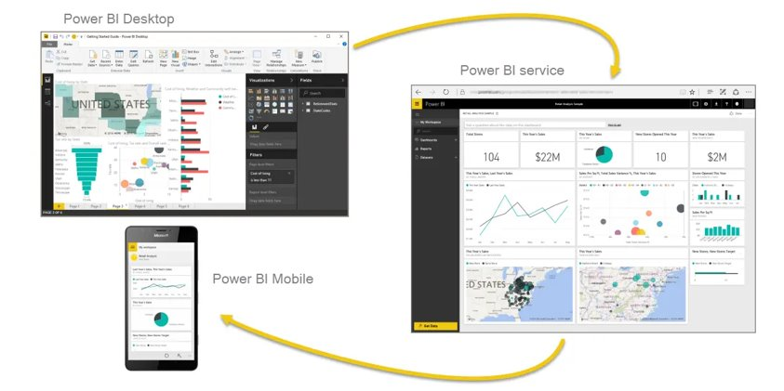
What is Power BI?
Connect to and visualize any data using the unified, scalable platform for self-service and enterprise business intelligence (BI) that’s easy to use and helps you gain deeper data insight.

Slide 6
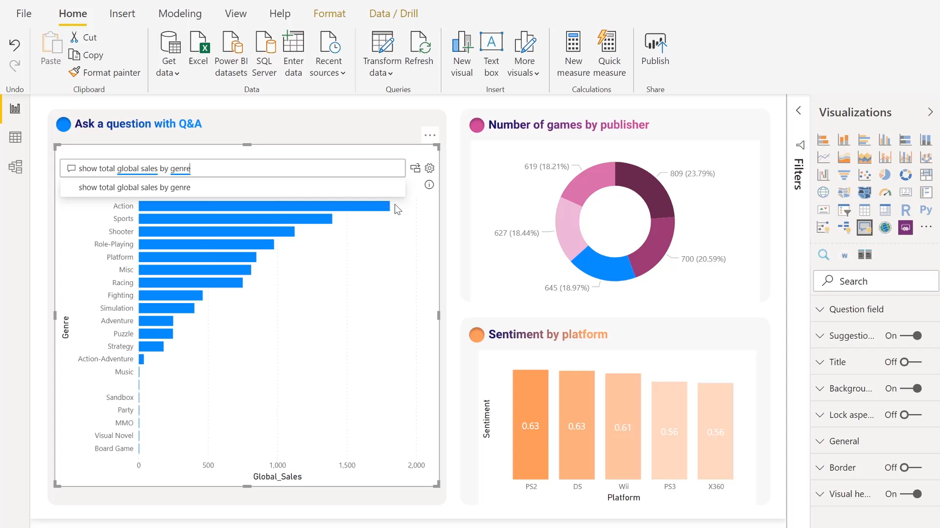
What Power Bi can do?
Create amazing data experiences:
Easily connect to, model, and visualize your data, creating memorable reports personalized with your KPIs and brand. Get fast, AI-powered answers to your business questions—even when asking with conversational language.

Slide 7
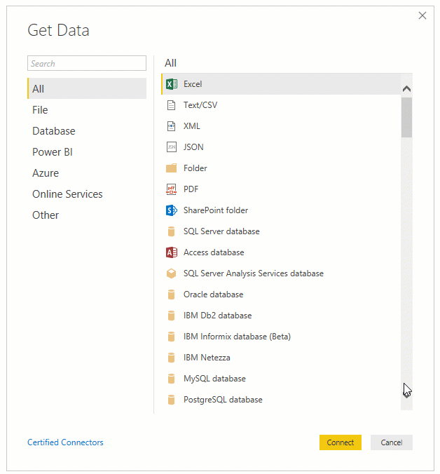
How to Get Data

Slide 8
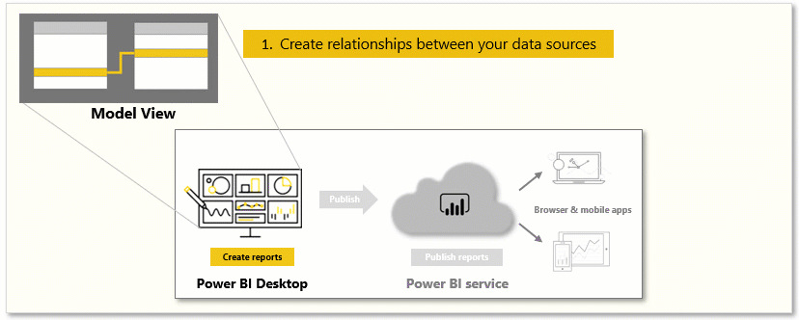
Model data

Slide 9
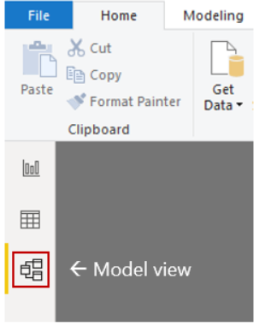
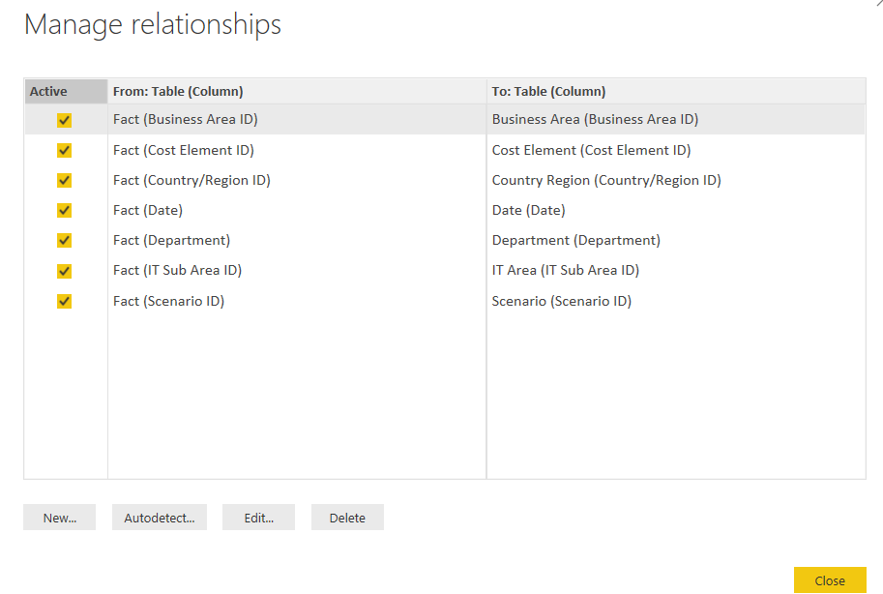
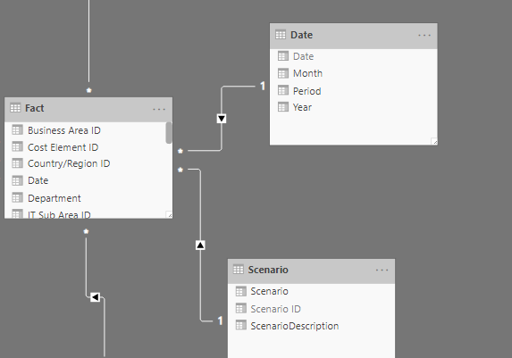

Slide 10
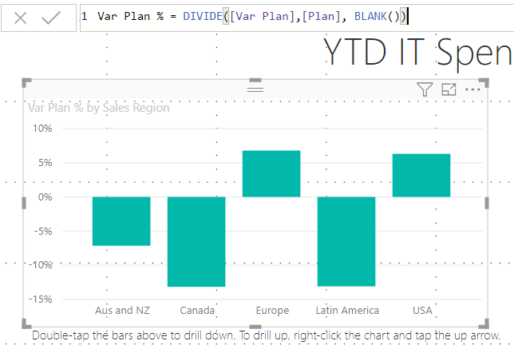
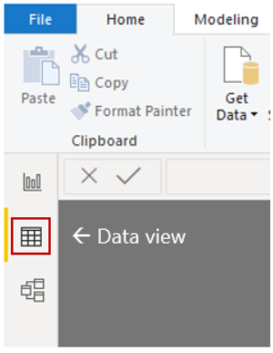
Model data (Measure)

Slide 11
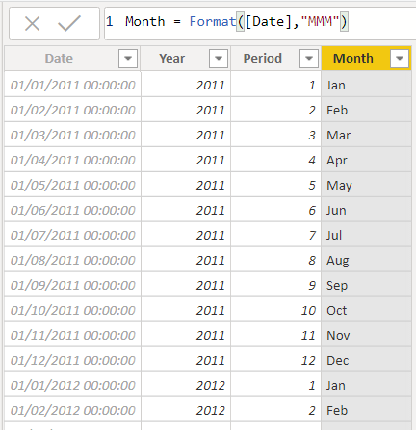
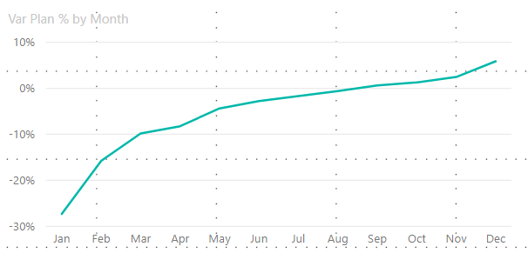
Model data (Calculated column)

Slide 12
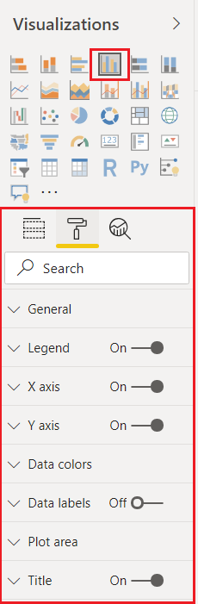
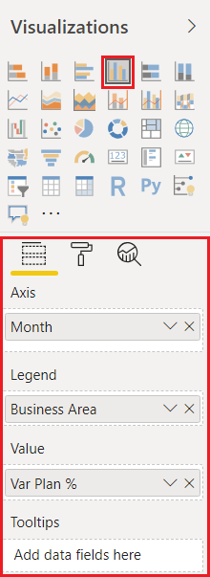
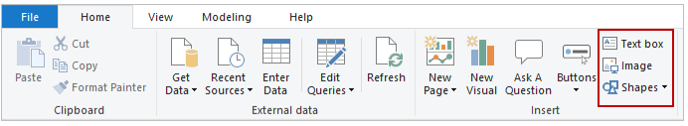
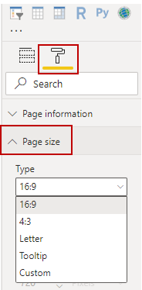
Use visuals

Slide 13
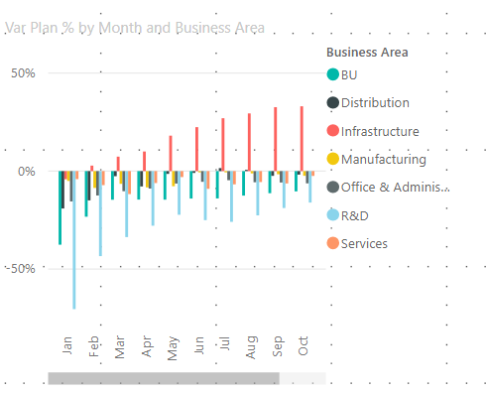
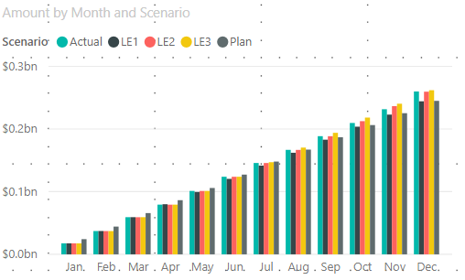
Use visuals - examples

Slide 14
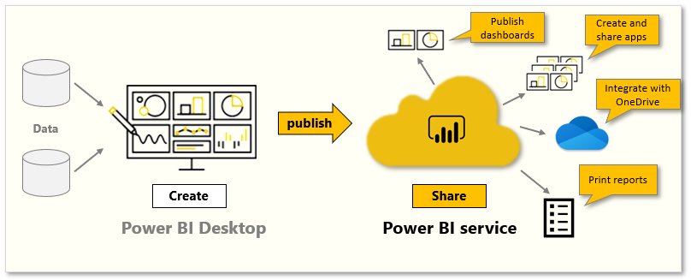
Publish and share

